Slide 1

Paper Presentation
《Bayesian Thurstonian models for ranking data using JAGS》
Chen ling NetID: ling10

Slide 2
《Bayesian Thurstonian models for ranking data using JAGS》
Author: Timothy R.Johnson and Kristine M.Kuhn
Published online: 29 March 2013
Journal: Psychonomic Society
This presentation is aimed to answer the following three questions:
What is thurstonian ranking model?
Why Bayesian technology is used in thurstonian model for ranking data ?
How to use Bayesian thurstonian model for ranking data?
Notes:
My paper presentation is about the paper 《Bayesian Thurstonian models for ranking data using JAGS》. The author is Timothy R.Johnson and Kristine M.Kuhn. It is published on Psychonomic Society on 29 March 2013. The paper uses JAGS to solve the thorstonian model for ranking data. This method helps us get rid of special technique used to solve thurstonian model for ranking data. I will answer following questions, What is thurstonian ranking model? Why Bayesian technology is used in thurstonian model for ranking data ? How to use Bayesian thurstonian model for ranking data?

Slide 3
What is thurstonian ranking model?
Thurstonian model:
Definition:
A latent variable model for describing the mapping of some continuous scale onto discrete possibly ordered categories of response.
Thurstonian model for ranking data
Assumes that observed rankings are consistent with a set of underlying continuous variable.
observed rankings
Underlying continuous variable
Notes:
Firstly, let’s see the definition of throstonian model. Thurstonian ranking model is a latent variable model for describing the mapping of some continuous scale onto discrete possibly ordered categories of response. When thurstonian model is used for ranking data, we Assumes that observed rankings are consistent with thous of a set of underlying continuous variables. Our goal is to get the distribution of such underlying continuous variables.

Slide 4
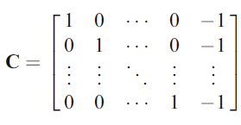
Formula of thurstonian ranking model
Feature of unobserved variables
Multivariate normal distribution
Various mean and covariate
Difference Expression
Where ,
The Probability distribution of a given rank order can be expressed as
Core Equation
Notes:
A thurstonian model ranking derives the probability of a given ranking on the basis of the distribution of a set of K unoberserved or latent response variables, ui1, ui2, to uiK, corresponding to the K ranked choices. These variables are assumed to have a multivariate normal distribution. Since we only want to know the rank of difference choice, It’s common to Represent thurstonian model in the differences of unobserved variables between the kth variable and Kth(i.e. last) choice. In matrix notation, zi equals C mu i, and C is a matrix like this.
The Probability distribution of a given rank order can be expressed as this core equation.
Where denotes the probability density function of a multivariate normal distribution with given mean vector and covariance matrix evalutated at z. Si is the set of value z1,z2,…zk-1 such that when combined with zk = 0, has the same rank order as yi1, yi2, yiK. I(z belong to Si) means if z belongs to Si I = 1 else 0.
This compute the probability that the multivariate, normally distributed vector zi with mean vector C mui and covariance matrix CsigmaC’ falls within Si to produce the observed rank order yi=(yi1, yi2, …, yiK).

Slide 5
Why Bayesian thurstonian model is used?
The most difficult part in thurstonian model is integration of core equation.
JAGS allows censoring of variables with an arbitrary joint distribution and therefore is very suitable for thurstonian ranking models
Notes:
Perhaps the most difficult part in thurstonian model is integration of core equation. It may not be expressed in a closed form. A lot of methods have been prompted to solve this problem. But they are not good enough. Only the Bayesian thurstonian model can be solved by JAGS. Because JAGS allows censoring of variables with an arbitrary joint distribution and therefore is very suitable for thurstonian ranking models. This is Why Bayesian thurstonian model is used.

Slide 6
Core Idea of Bayesian thurstonian ranking model
Multivariate normal distribution
dinterval function in JAGS
For example implies the region of
is , recall that
Notes:
The paper introduce us how to use JAGS to conduct analyses using thurstonian ranking models.
The core idea is to specify the rank-censoring mechanism. This can be done by using some of the built-in programming functions to define bounds for the dinterval “distribution” in JAGS. This functionality is intended for censored responsive variables, such as in survival models, but it can also be used to specify the censoring of Zi1, Zi2,…,Zik-1 implied by an observed ranking. Which means, by use of dinterval function, we can simulate the parameter posterior distribution.

Slide 7
Example: Relation between ranking of compensation plans and cultural orientation
4 Cultural and person types
 | Collectivism | Individualism
Vertical Self | VC | VI
Horizontal Self | HC | HI
Choice of compensation plans: a ranking set
 | y1 | y2 | y3 | y4
Compensation plans | Individual bonus | Team bonus | Profit sharing | Seniority based
Example of dataset
i | y1 | y2 | y3 | y4 | VC | HC | VI | HI
1 | 3 | 2 | 1 | 4 | 4.2 | 4.57 | 5.23 | 6
2 | 1 | 4 | 2 | 3 | 4.3 | 6.7 | 2 | 4.3
Notes:
Let’s see an example: the relation between ranking of compensation plans and cultural orientation. The respondant is require to rank his preference of four type of compensation plan, including Individual bonus, Team bonus, Profit sharing, and Seniority based. He also gets the scores on four type of cultural orientation: such as Vertical Collectivsim, Vertical Individualism, Horizonal Collectivism and Horizonal individualism.
Below is two examples of dataset.
Now, let’s see what will happen if we apply a Bayesian thurtonian ranking model to this database in order to examine the preference of compensation plans based on cultural orientation.

Slide 8
Set up thurstonian ranking model
Setup mean equation
Let
Difference equation
The meaning of parameter: capture the effect of difference choice when variable changes.
Respondents prefer the k’th choice rather kth choice when hi increases
Notes:
To begin with, we setup the model and difference equation model, here the parameter is to capture the effect of difference choice when variable changes.
You could read the explaintion on the slide.

Slide 9
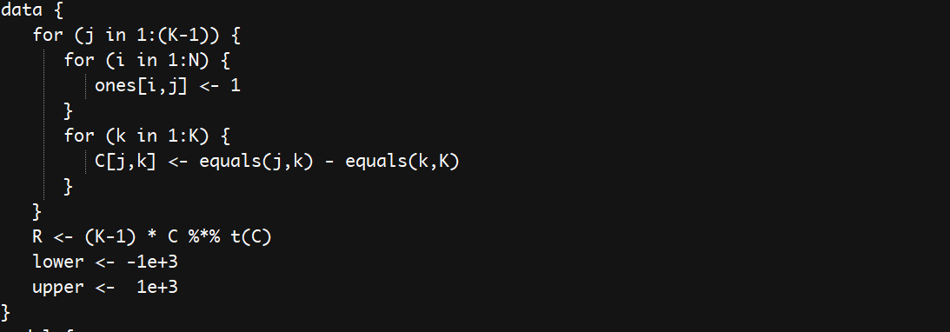
Key Code Analysis: JAGS files
Initilization of data
Notes:
Here is the code of JAGS file. This is data initialization part.

Slide 10
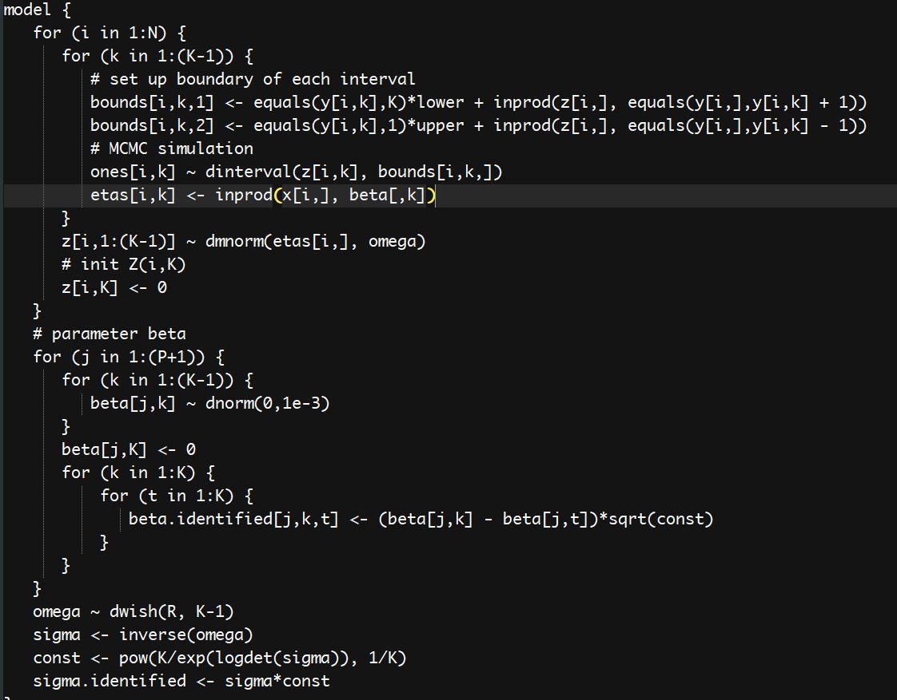
Key Code Analysis: JAGS files
Notes:
And these codes is for model part. we set up the boundary of each interval and use dinterval to simulation the posterior distribution.

Slide 11
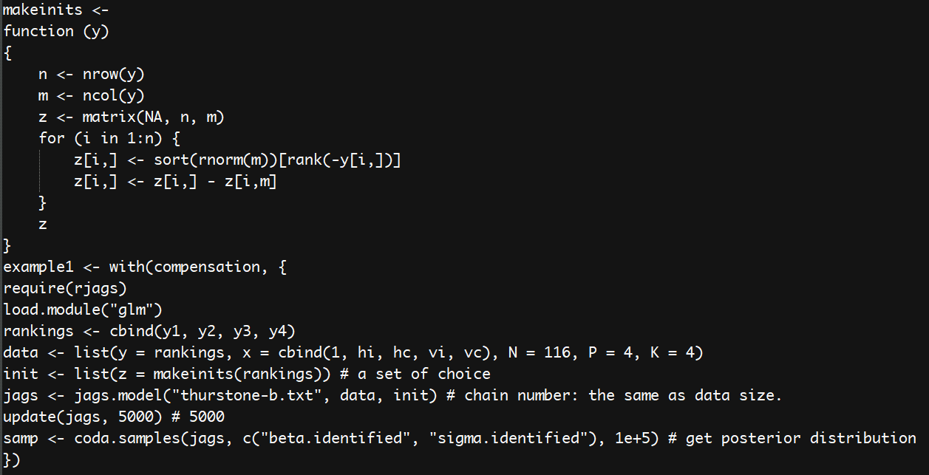
Key Code Analysis: R file
Notes:
This part is supposed to run in R. makeinits is the function that generates init list for JAG model. The chain number is the data size. Then the regular operation such as update and coda are used to get posterior distribution.

Slide 12
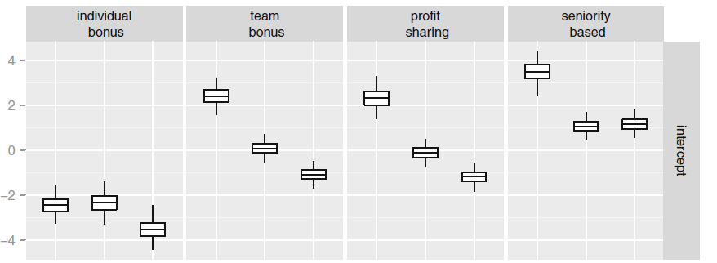
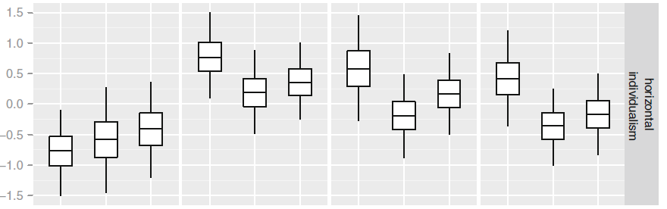
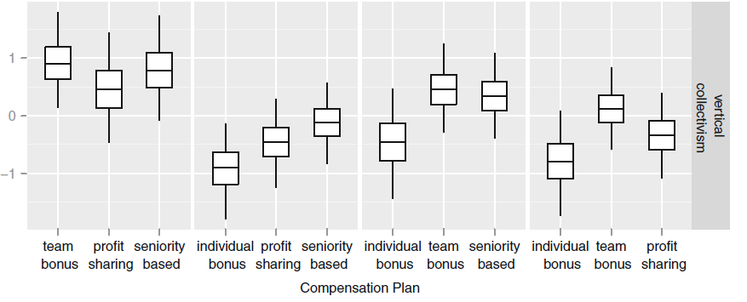
Plot of posterior distribution for the parameter difference for a given pair of compensation plans (part)
Parameter of Horizontal Individualism
in the red area:
Team bonus
Profit sharing
Individual bonus
Seniority based
Conclusion:
Increase in horizontal individualism results in a
preference for individual bonus.
Picture From
《Bayesian Thurstonian models for ranking data using JAGS》
Notes:
Now here is the plot of posterior distribution for the parameter difference for a given pair of compensation plans and culture orientation.
Let’s focus on the area of the red rectangle, we can read the relation between the Horizontal Individualism and individual bonus.
It’s clear that the difference between the horizontal individualism and the three subscale of individual bonus: which are team bonus, profit sharing, and seniority based are all below zero.
So we may have confident to conclude that any Increasing in horizontal individualism results in a preference for individual bonus.
In conclusion, Bayesian and JAGS can help with solving thurstonian ranking model by use of dinterval function and generate parameter posterior distribution easily. It is very helpful in processing ranking data.

Slide 13
Thank you!
Notes:
Thank you for your attention.

